Slide 1
IT 6823 LM 8 – Malware
Dr. Lei Li

Slide 2
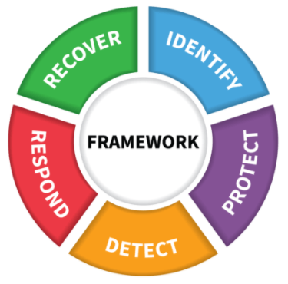
NIST Framework Core
Image source: https://www.nist.gov/document/cybersecurityframeworkv1-1presentationpptx

Slide 3
Learning Outcomes
Describe what is vulnerability assessment and its main benefits
Explain the steps in the vulnerability assessment process
Discuss why penetration testing is needed
Explain the approaches and types of penetration testing
Compare and contrast vulnerability scan and penetration testing

Slide 4

Vulnerability Analysis
Identifying security vulnerabilities
Closing down security gaps
Getting compliant
Maintaining strong security
Should be conducted regularly
Image source: https://images.app.goo.gl/1chxWVgaKxd4noTi9

Slide 5
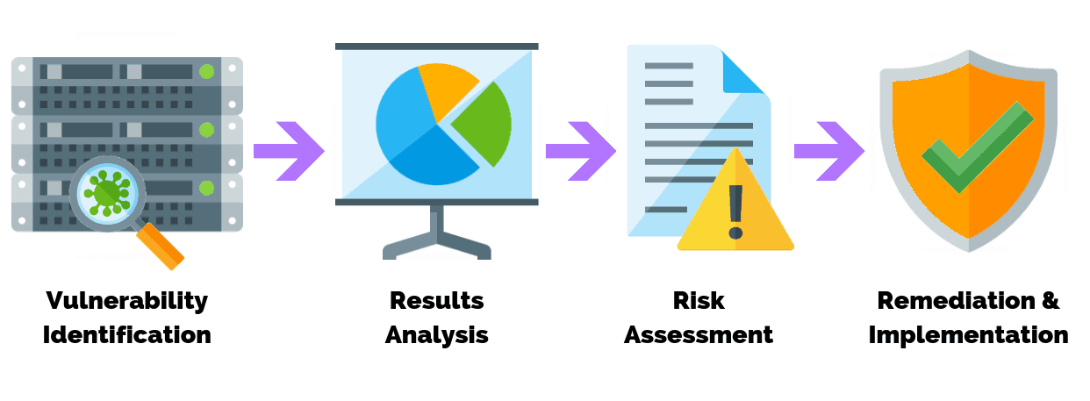
Vulnerability Assessment
Image source: https://purplesec.us/perform-successful-network-vulnerability-assessment/

Slide 6
Vulnerability Assessment Process
Step 1: conduct risk identification and analysis
Step 2: vulnerability scanning policies and procedures
Step 3: identify the types of vulnerability scans
Step 4: configure the scan
Step 5: perform the scan
Step 6: evaluate and consider possible risks
Step 7: interpret the scan results
Step 8: create a remediation process & mitigation plan

Slide 7
Vulnerability Assessment Process –cont.
Step 1: conduct risk identification and analysis
Threats & vulnerabilities to the assets
Prioritize assets
LM 3. risk management
Step 2: vulnerability scanning policies and procedures
Policy & procedures should in place
Vulnerability scan configuration & functionality
Type of scan
LM4. information security policy

Slide 8

Step 3: Identify Types of Vulnerability Scans
Who perform the scan
Network vulnerability scans
Host-based vulnerability scans
Wireless-based vulnerability scans
Application-based vulnerability scans
Image source: https://purplesec.us/perform-successful-network-vulnerability-assessment/

Slide 9
Step 4: Configure the Scan
Add A List Of Target IPs
Defining Port Range And Protocols
Defining The Targets
Setting Up The Aggressiveness Of The Scan, Time And Notifications

Slide 10

Step 5: Perform the Scan
Scanning
Enumeration
Vulnerability Detection
Image source: https://purplesec.us/perform-successful-network-vulnerability-assessment/

Slide 11
Vulnerability Assessment Process –cont.
Step 6: evaluate and consider possible risks
Extra caution for scanning critical systems
Step 7: interpret the scan results
Having a qualified staff member
Prioritize the identified vulnerabilities
Step 8: create a remediation process & mitigation plan
Mitigation plan – more in LM10
Follow up scans

Slide 12
CVSS Database
Common Vulnerability Scoring System
Industry standard
Scale of 0 to 10
CVSS v3.0 Ratings
Severity | Base Score Range
None | 0.0
Low | 0.1-3.9
Medium | 4.0-6.9
High | 7.0-8.9
Critical | 9.0-10.0

Slide 13
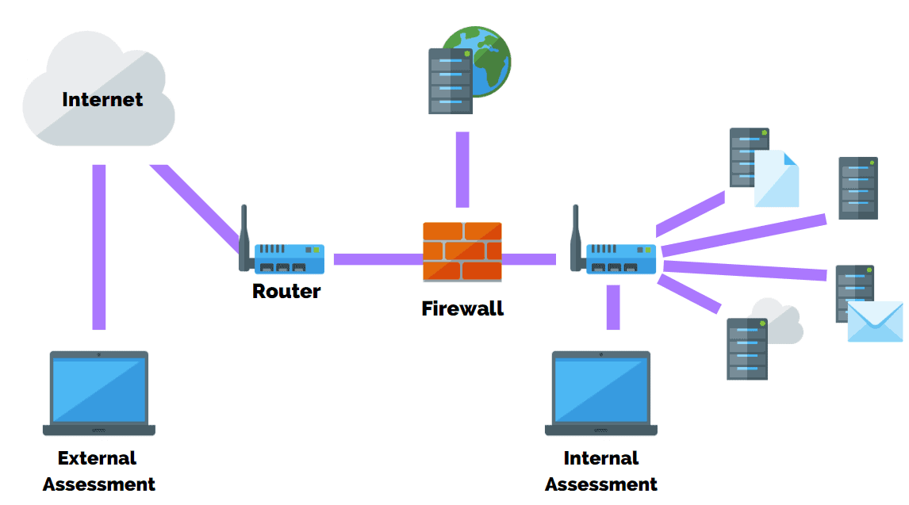
Penetration Testing
Simulated attack to exploit weaknesses and vulnerabilities
Image source: https://purplesec.us/types-penetration-testing/#Goal

Slide 14
Benefits of Penetration Testing
Determining weakness in the hardware, software, or human assets
Maintaining the 3 triads of cyber security
Ensuring that controls which have been implemented are adequate.
Providing intelligence and insight of an organization’s security measures
Improving the overall security posture of an organization

Slide 15
Penetration Testing Approaches
Black Box
External pen testing
Simulate real world cyber attack
White Box
Internal pen testing
In-depth security audit
Gray Box
Partial system knowledge
More focus

Slide 16
Types of Penetration Testing
Network Services
Web Application
Client Side
Wireless
Social Engineering
Physical Penetration Testing

Slide 17
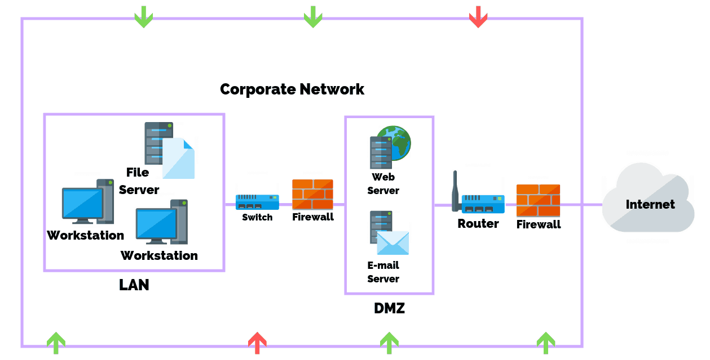
Network Service Penetration Testing
Identify most exposed vulnerabilities in network infrastructure
Image source: https://purplesec.us/types-penetration-testing#Involve

Slide 18
Network Service Pen Testing – cont.
Protect from common network-based attacks
Firewall Misconfiguration And Firewall Bypass
IPS/IDS Evasion Attacks
Router Attacks
DNS Level Attacks:
SSH Attacks
Proxy Server Attacks
Unnecessary Open Ports Attacks
Database Attacks
Man In The Middle (MITM) Attacks
FTP/SMTP Based Attacks

Slide 19
Web Application Penetration Testing
Identify and prioritize security weakness and vulnerabilities
in web-based applications, browsers, and their components
Best practice to continuously improve its codebase
Balance daily code deployment with security in mind
Tech giant offer rewards for finding vulnerabilities in their apps.

Slide 20
Client-Side Penetration Testing
Client-side applications
Identify cyber attacks
Cross-Site Scripting Attacks
Clickjacking Attacks
Cross-Origin Resource Sharing (CORS)
Form Hijacking
HTML Injection
Open Redirection
Malware Infection

Slide 21
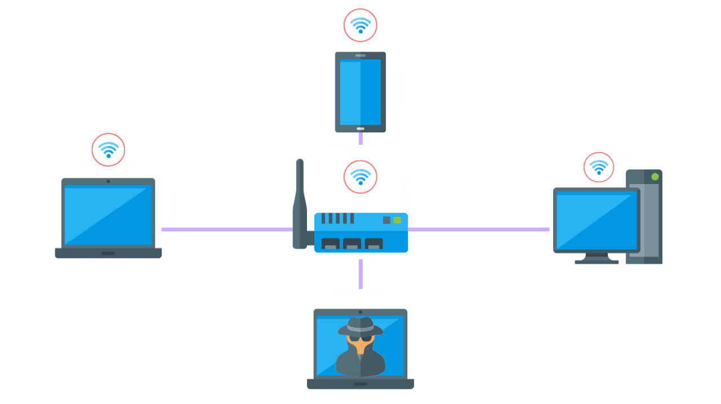
Wireless Penetration Testing
All devices connected to wifi
Can be done on site or remotely
Image source: https://purplesec.us/types-penetration-testing#Involve

Slide 22
Social Engineering Penetration Testing
Malicious actor attempts to persuade or trick users
98% of cyber attacks rely on social engineering - LM7 Malware
Common social engineering attacks
Phishing Attacks
Tailgating
Imposters (i.e. Fellow Employees, External Vendors, or Contractors)
Name Dropping
Pre-texting
Etc.

Slide 23

Physical Penetration Testing
Simulate real-world threat on physical barriers
Infrastructure, building, systems, or employees
Expose weakness in physical controls
Image source: https://purplesec.us/types-penetration-testing#Involve

Slide 24
Vulnerability Ccan vs. Penetration Testing
Items | Vulnerability scan | Penetration Cost
Objectives | Identify and report potential vulnerabilities in the system | Simulated attacks to detect and exploit weakness in the system
Process | Often automated, high level test | Hands-on by a real person
Results | Less accurate and less details | More accurate and thorough
Cost | Generally, very affordable | More costly
Time to complete | Quick to complete | Take more time (1 day to weeks)
Frequency | Weekly/monthly/quarterly | Annually or after significant change

Slide 25
Vulnerability Scan
Benefits
Quick, high-level look at possible vulnerabilities
Very affordable
Automatic
Quick to complete
Limitations
False positives
Businesses must manually check each vulnerability before testing again
Does not confirm that a vulnerability is exploitable

Slide 26
Penetration Testing
Benefits
Live, manual tests mean more accurate and thorough results
Retesting after remediation is often included
Rules out false positives
Annual test, or after any significant change
Limitations
Takes more time (e.g., 1 day to 3 weeks)
Cost more (e.g., $15,000 to $70,000)

Slide 27
Putting Together
Both work together for better security
Vulnerability scan
Regular insight into your network security
Quick X-ray
Penetration test
Thorough and deep examination of network security
Periodic detailed MRI

